Slide 1
Sustainable Digital Humanities Collections
Eve Ansell, Dr Nichola Burton, Dr Ian McCrabb,
Mike Lynch, Dr Peter Sefton

Slide 2
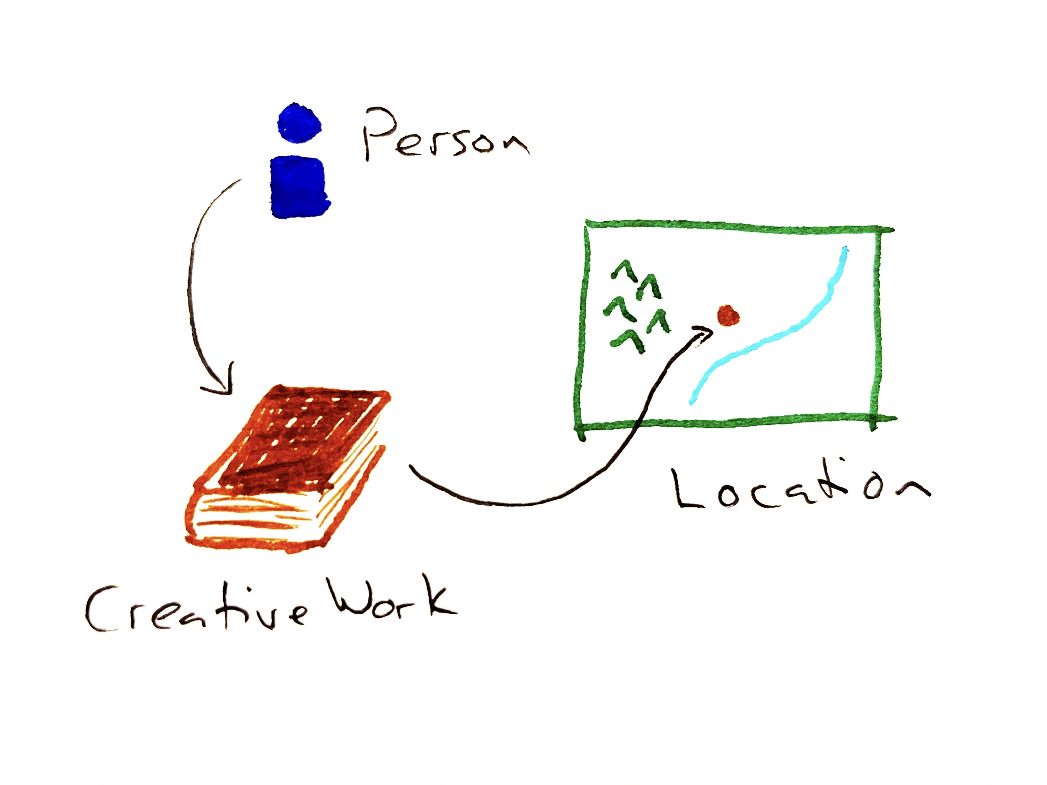
Welcome and introductions
Curated Collections
Successful approaches to digital humanities
Finding collections at risk
Meeting researcher needs
Metadata and standards
Next steps
Notes:
Hi and thank you for coming to this BoF. I'm Mike Lynch and I'm a software engineering and research compute group lead at the Sydney Informatics Hub at the University of Sydney.
I'll get everyone on the panel to introduce themselves -
I'll start with an introduction of the Curated Collections ARDC project, and then Ian will give a short presentation about successful approaches to working with digital humanities collections at Systemik Solutions.
For the rest of the session, we've got four questions which we want to spark contributions from you about how this project needs to work – with an emphasis on community building and engagement.

Slide 3
Curated Collections
ARDC HASS and Indigenous Community Data Lab
National platform for digital humanities collections
Support, training and community
2025 Pilot
Migrations
Release v1
2026
Workshops Features
Release v2
2027-28 Migrations
Archives
Release v3
Notes:
Curated Collections is a project we’ve started at the University of Sydney, funded by the ARDC, to provide a national platform for digital humanities collections. The platform is Omeka S hosted on Nectar, but this session is not about the tech stack. It’s about how we provide support and training for the platform and build a community of practice to mitigate the risks which digital humanities collections face.
This is the project timeline - we are aiming for a pilot release by the end of the year, including migrations of current collections at USyd, and a few new projects from researchers who are happy to be beta testers.
Next year we will be developing training and working on building out the platform based on gaps we identified this year, working towarsd a second release
The third phase of the project will bring more collections from other institutions on board, and build out some of the technical features which are intended to make the collections hosted in the platform sustainable

Slide 4
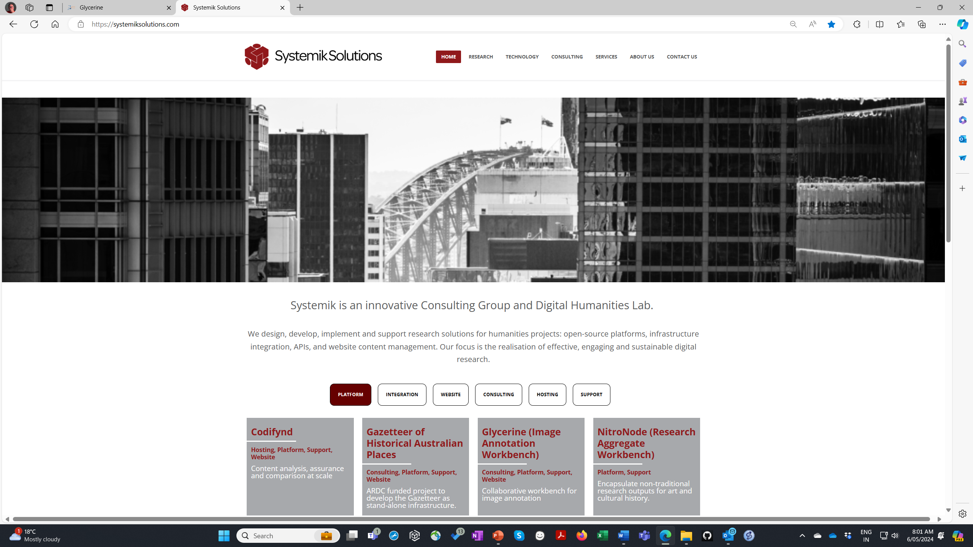

Slide 5
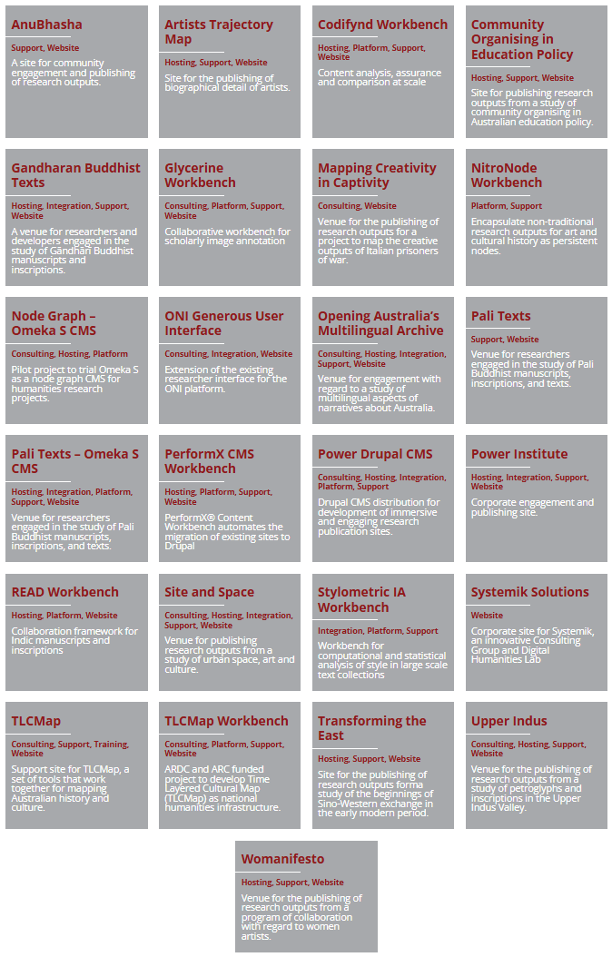
Exemplar Projects

Slide 6
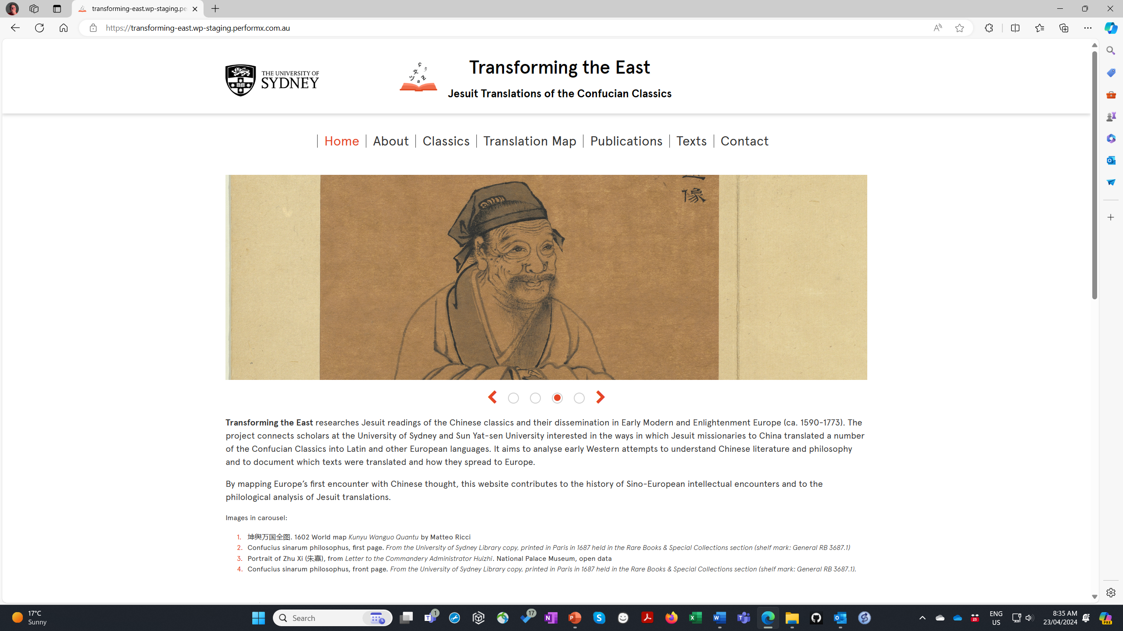
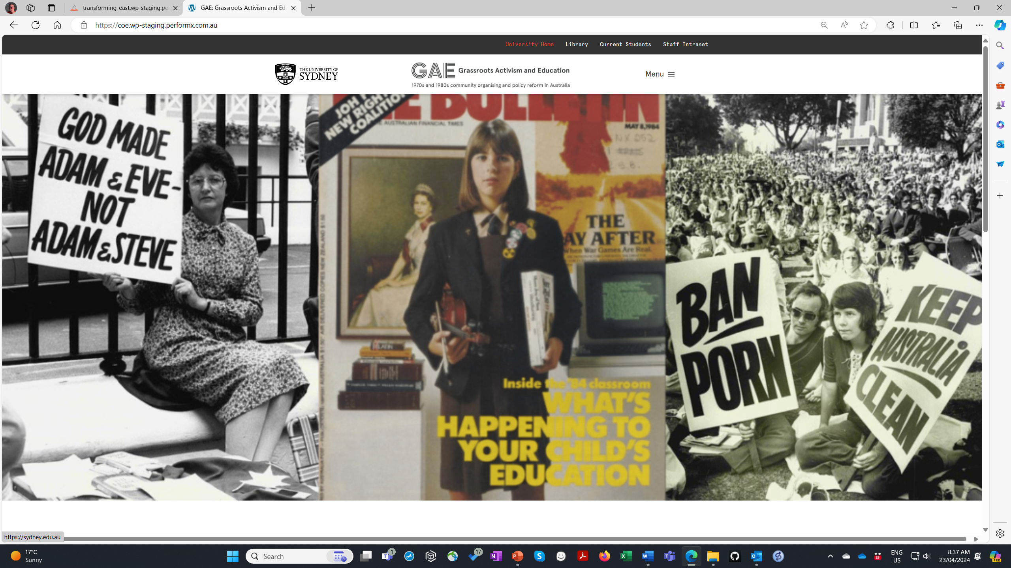
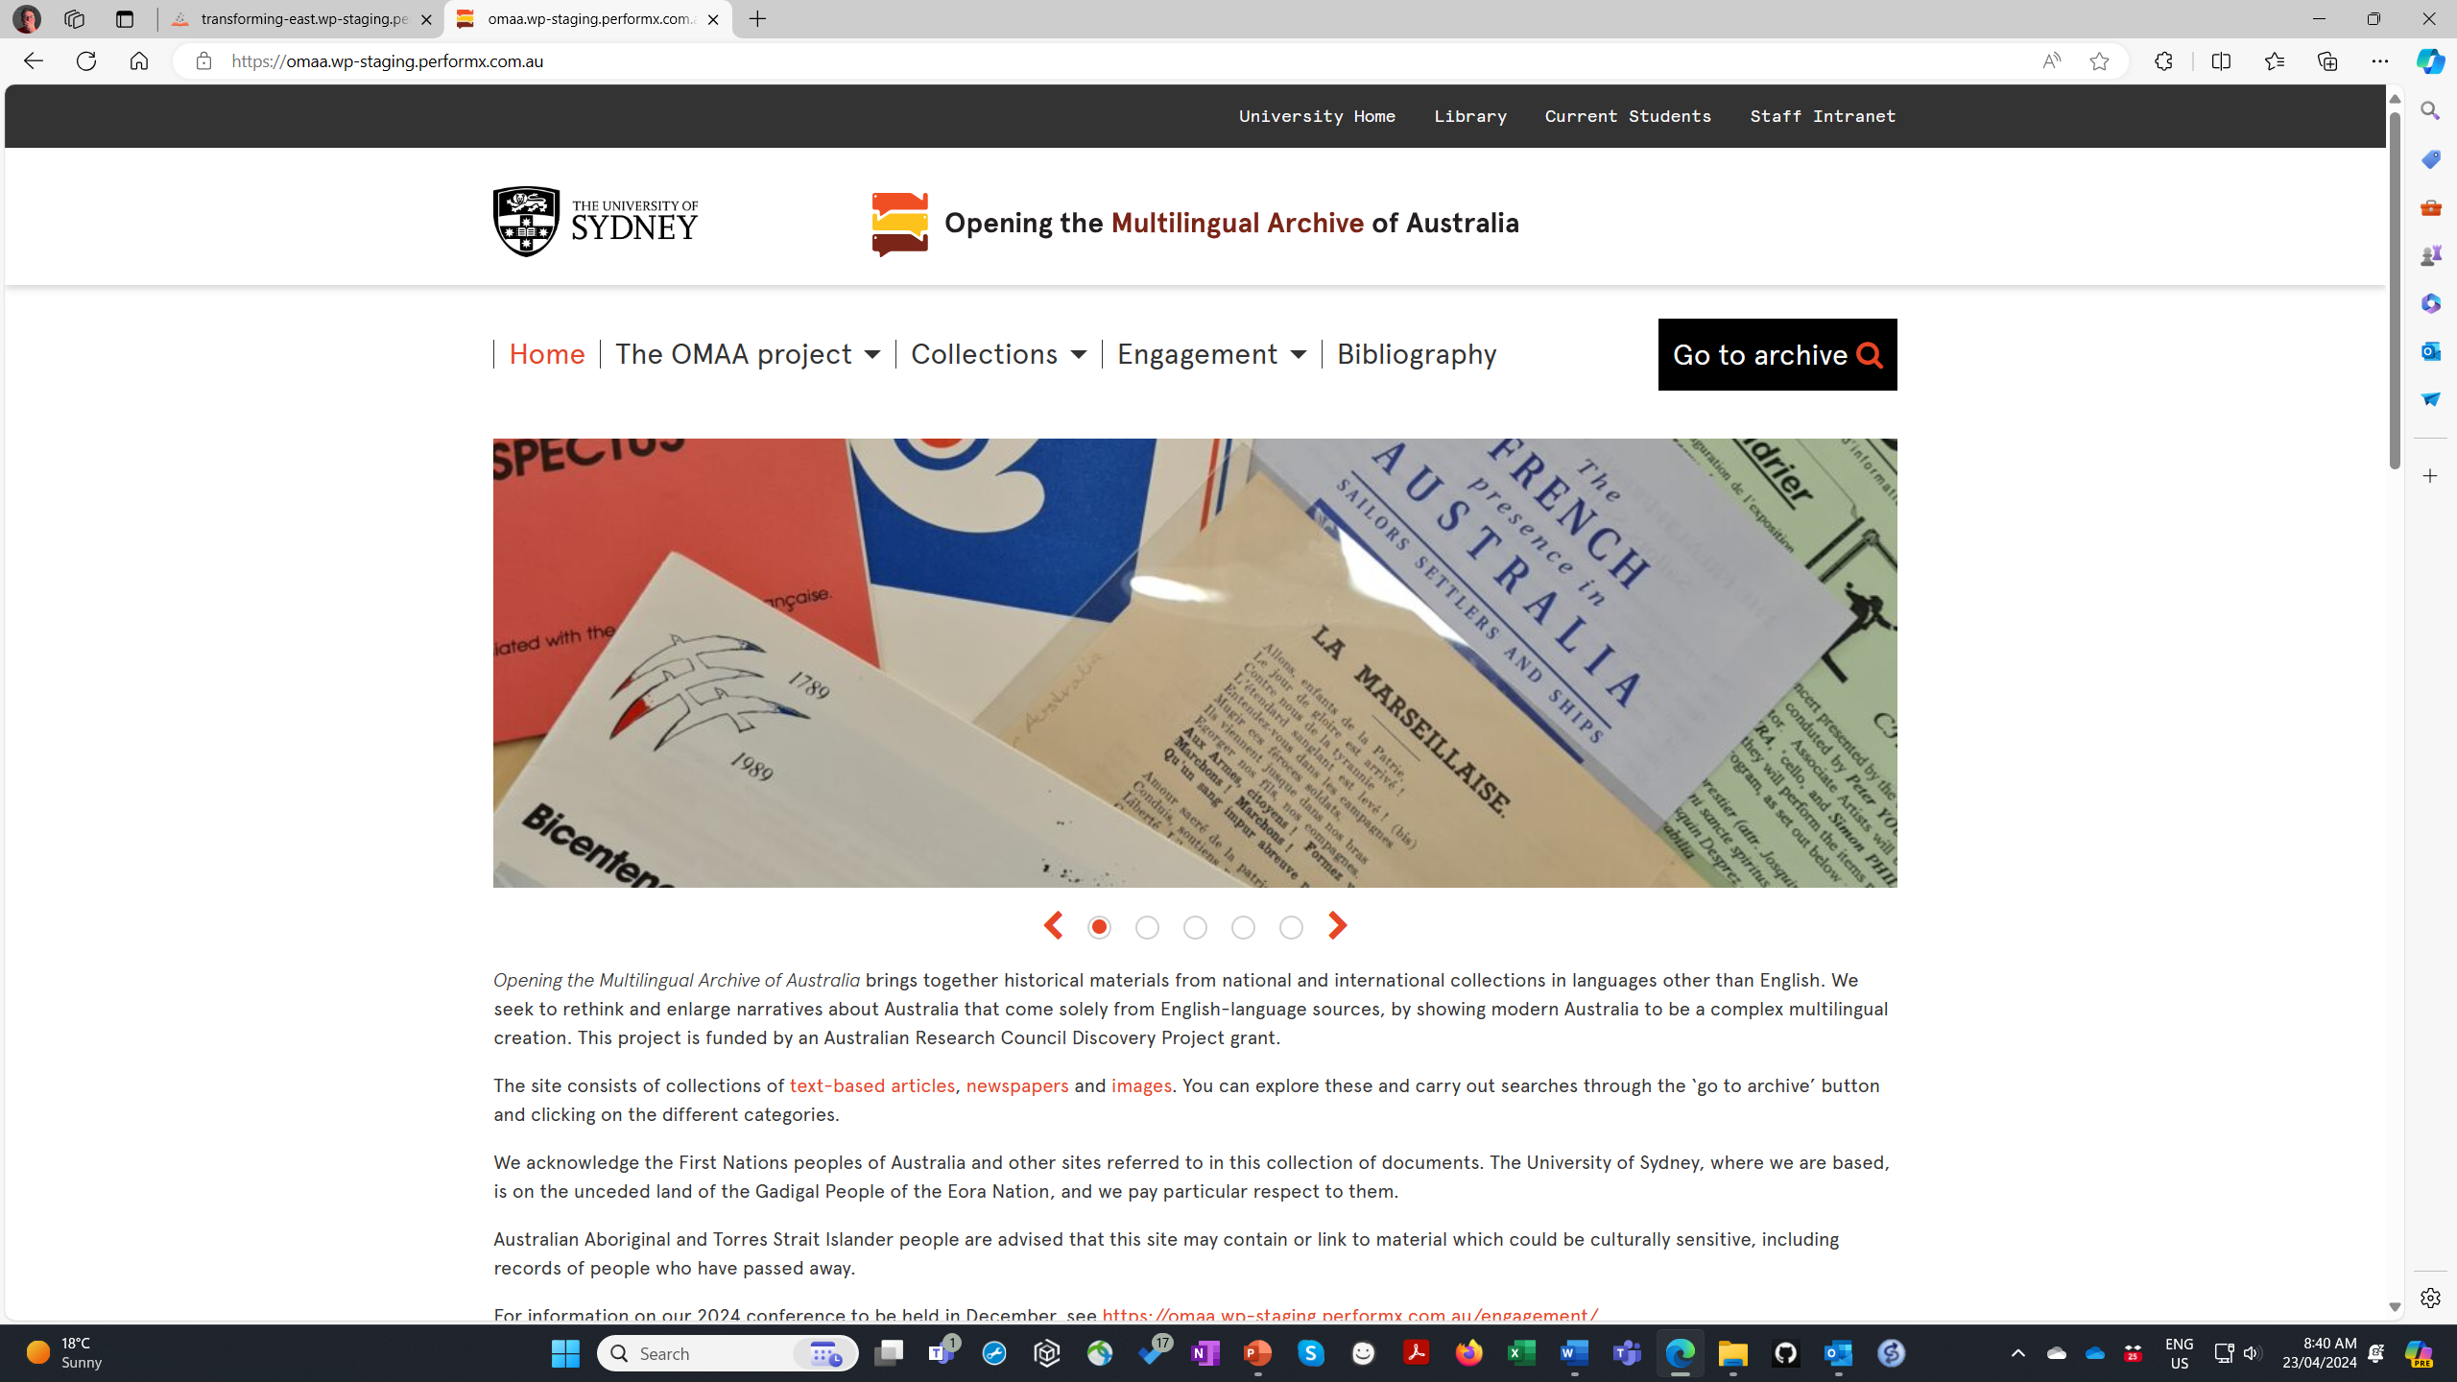

Slide 7
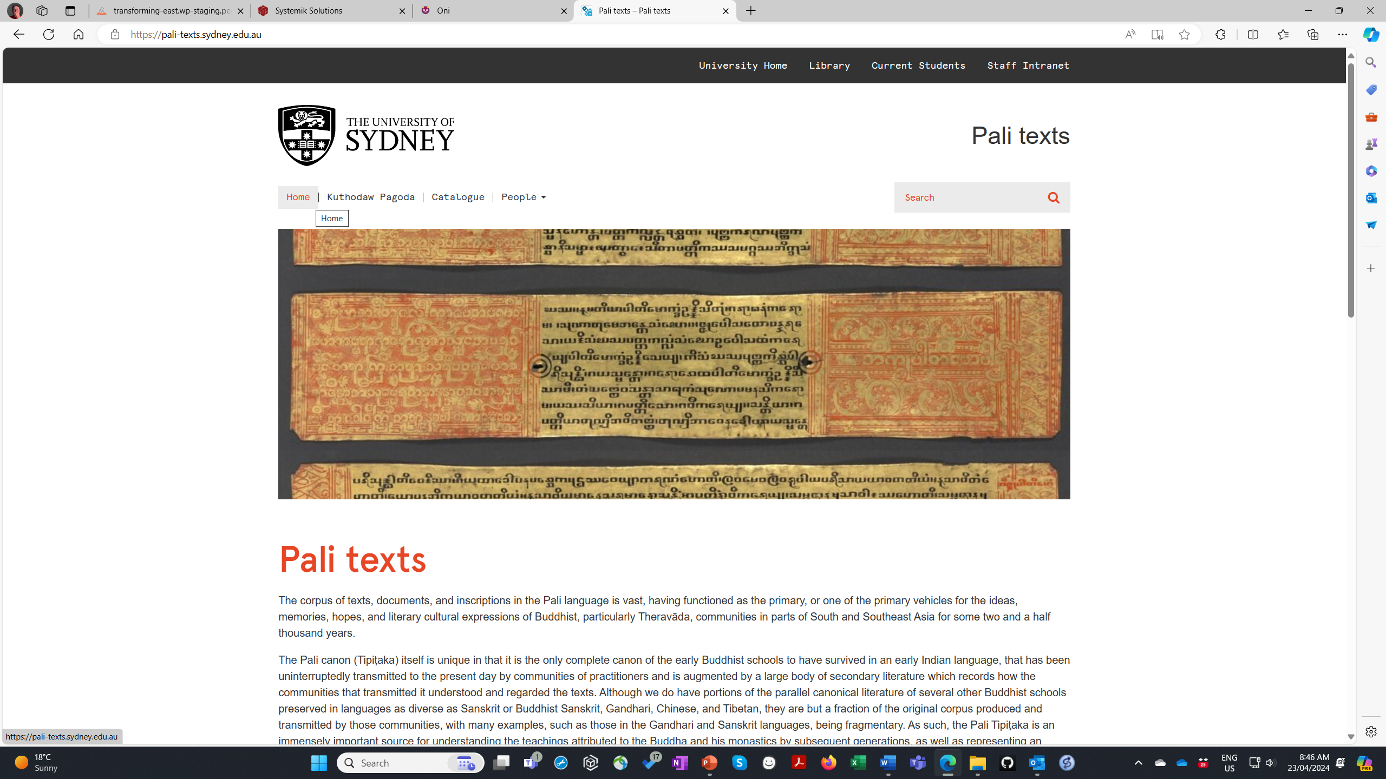
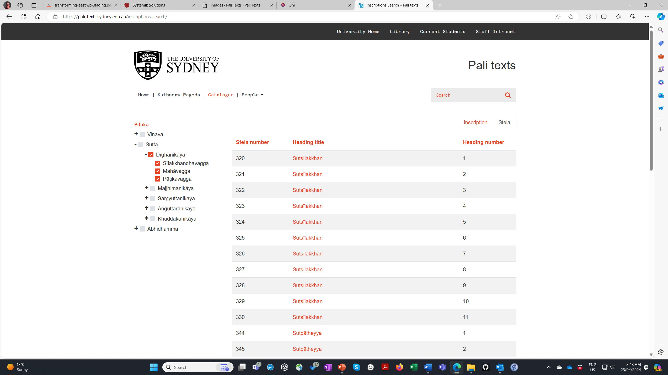
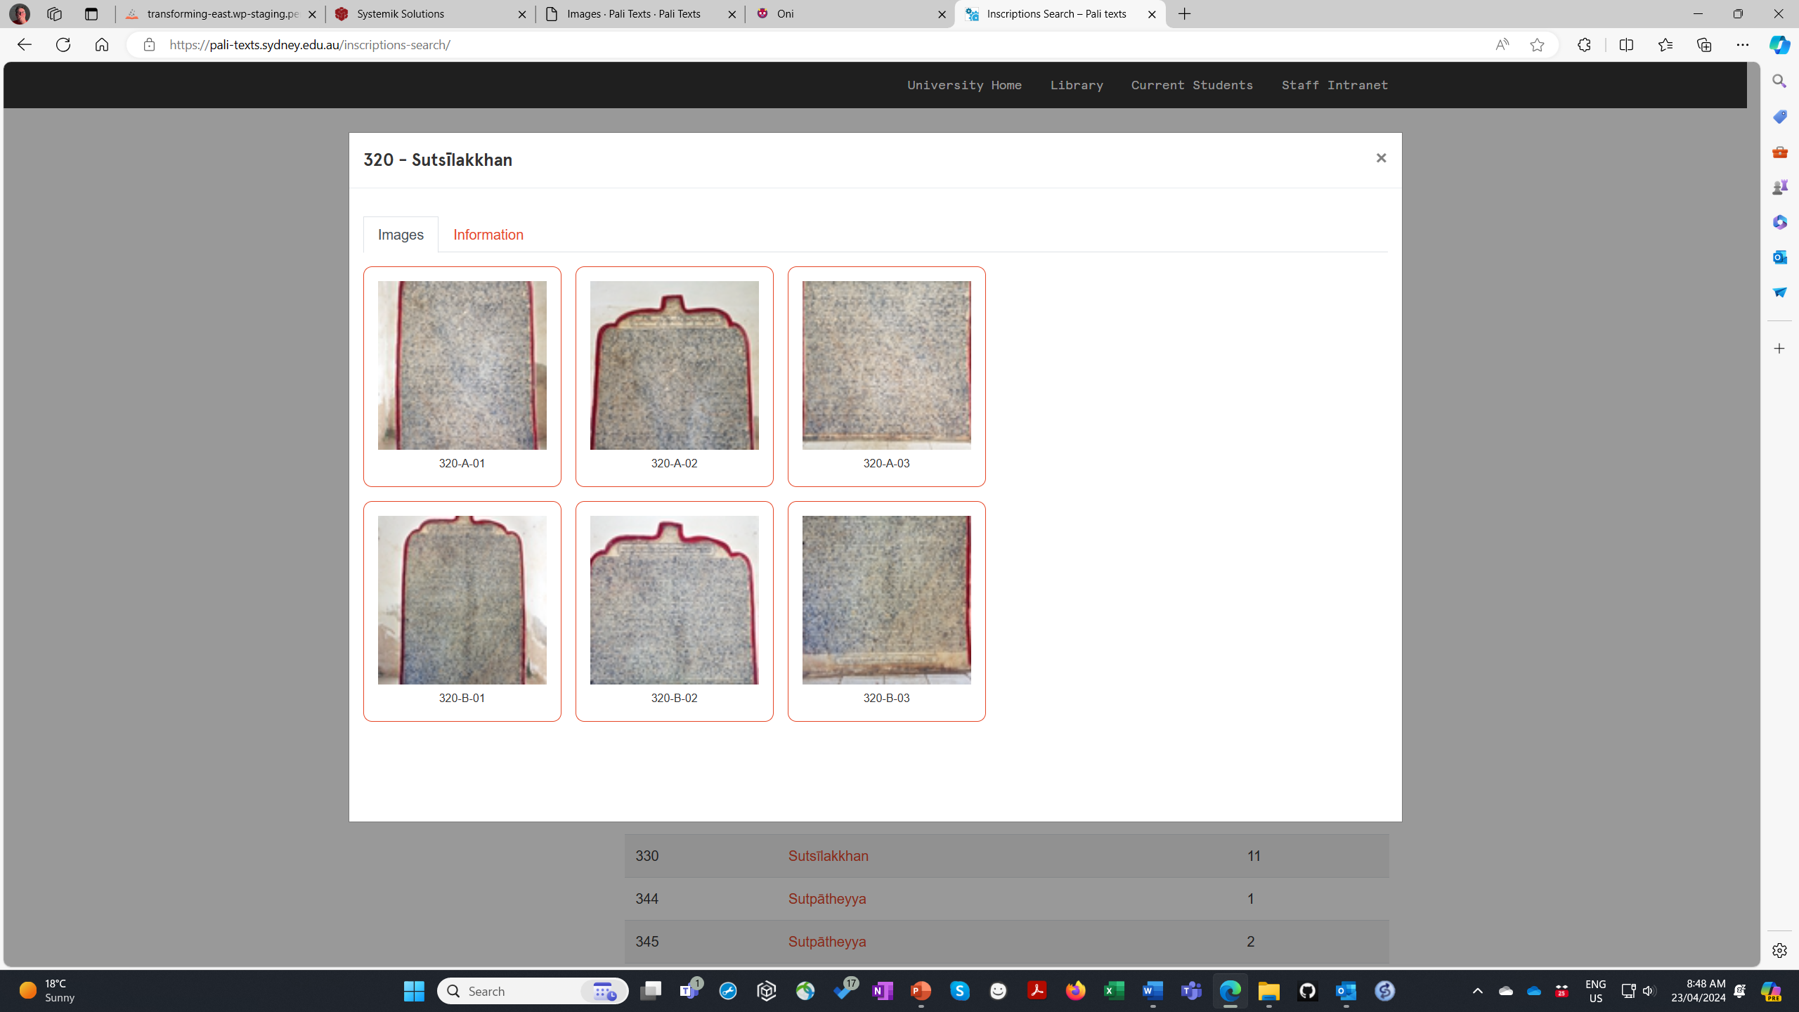

Slide 8
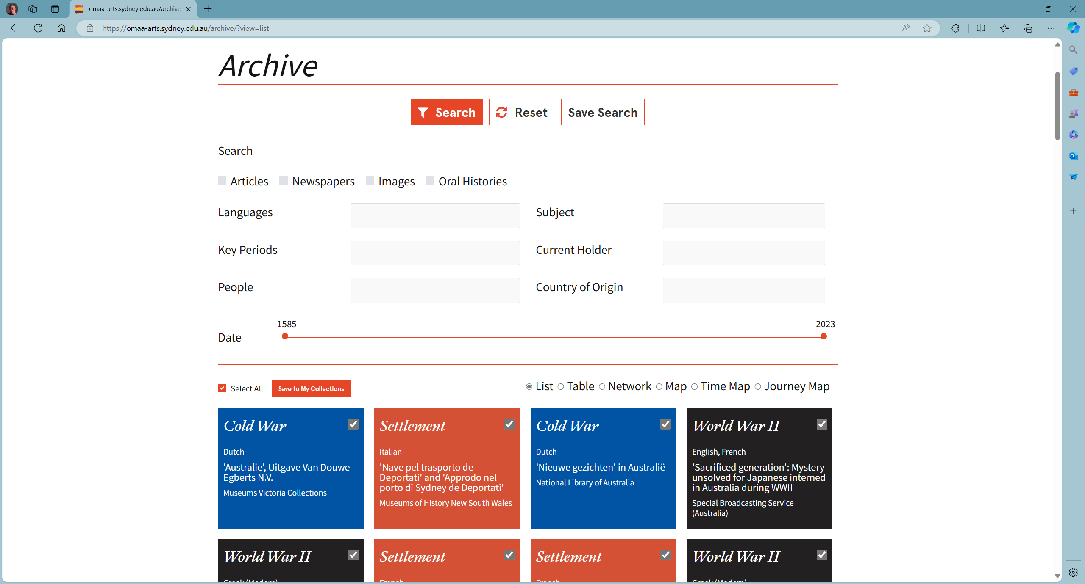
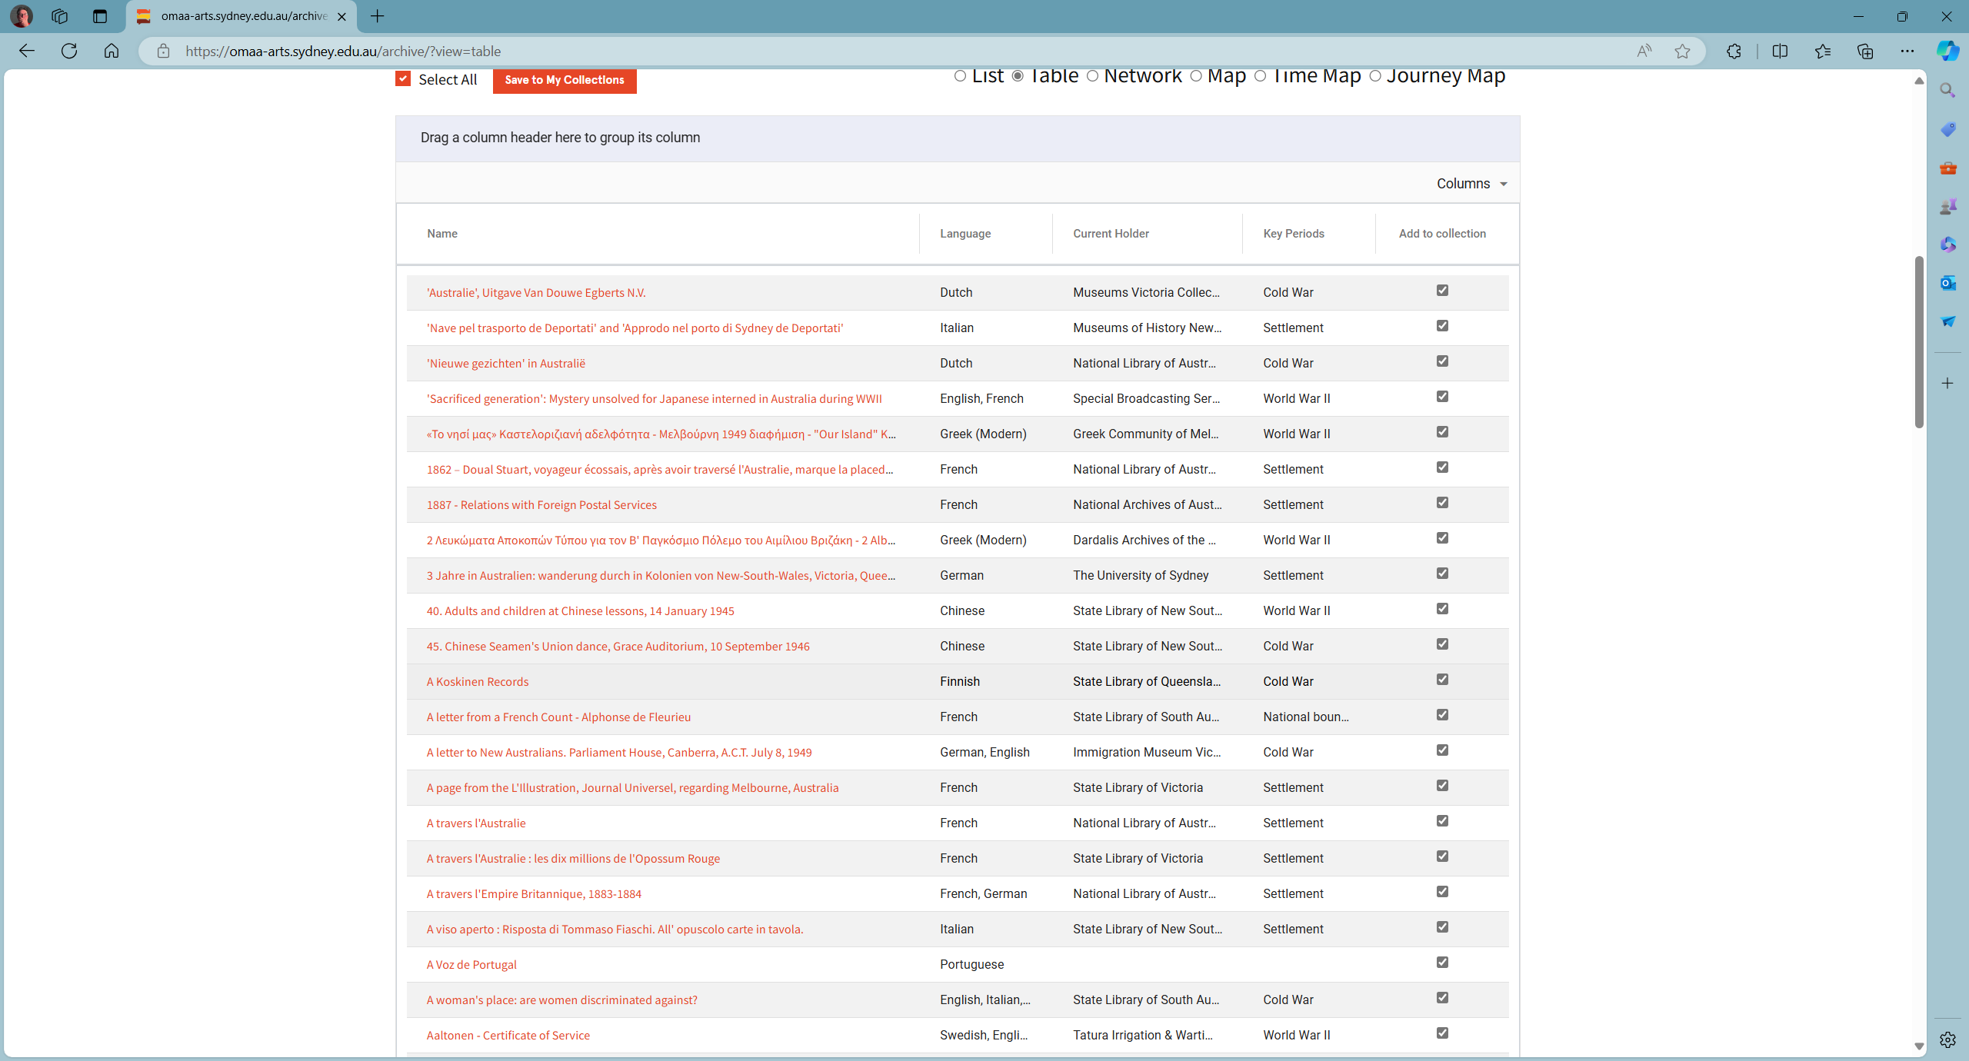
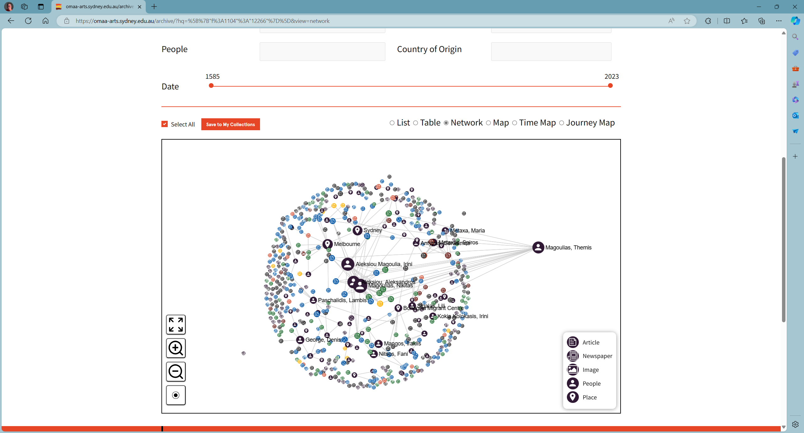
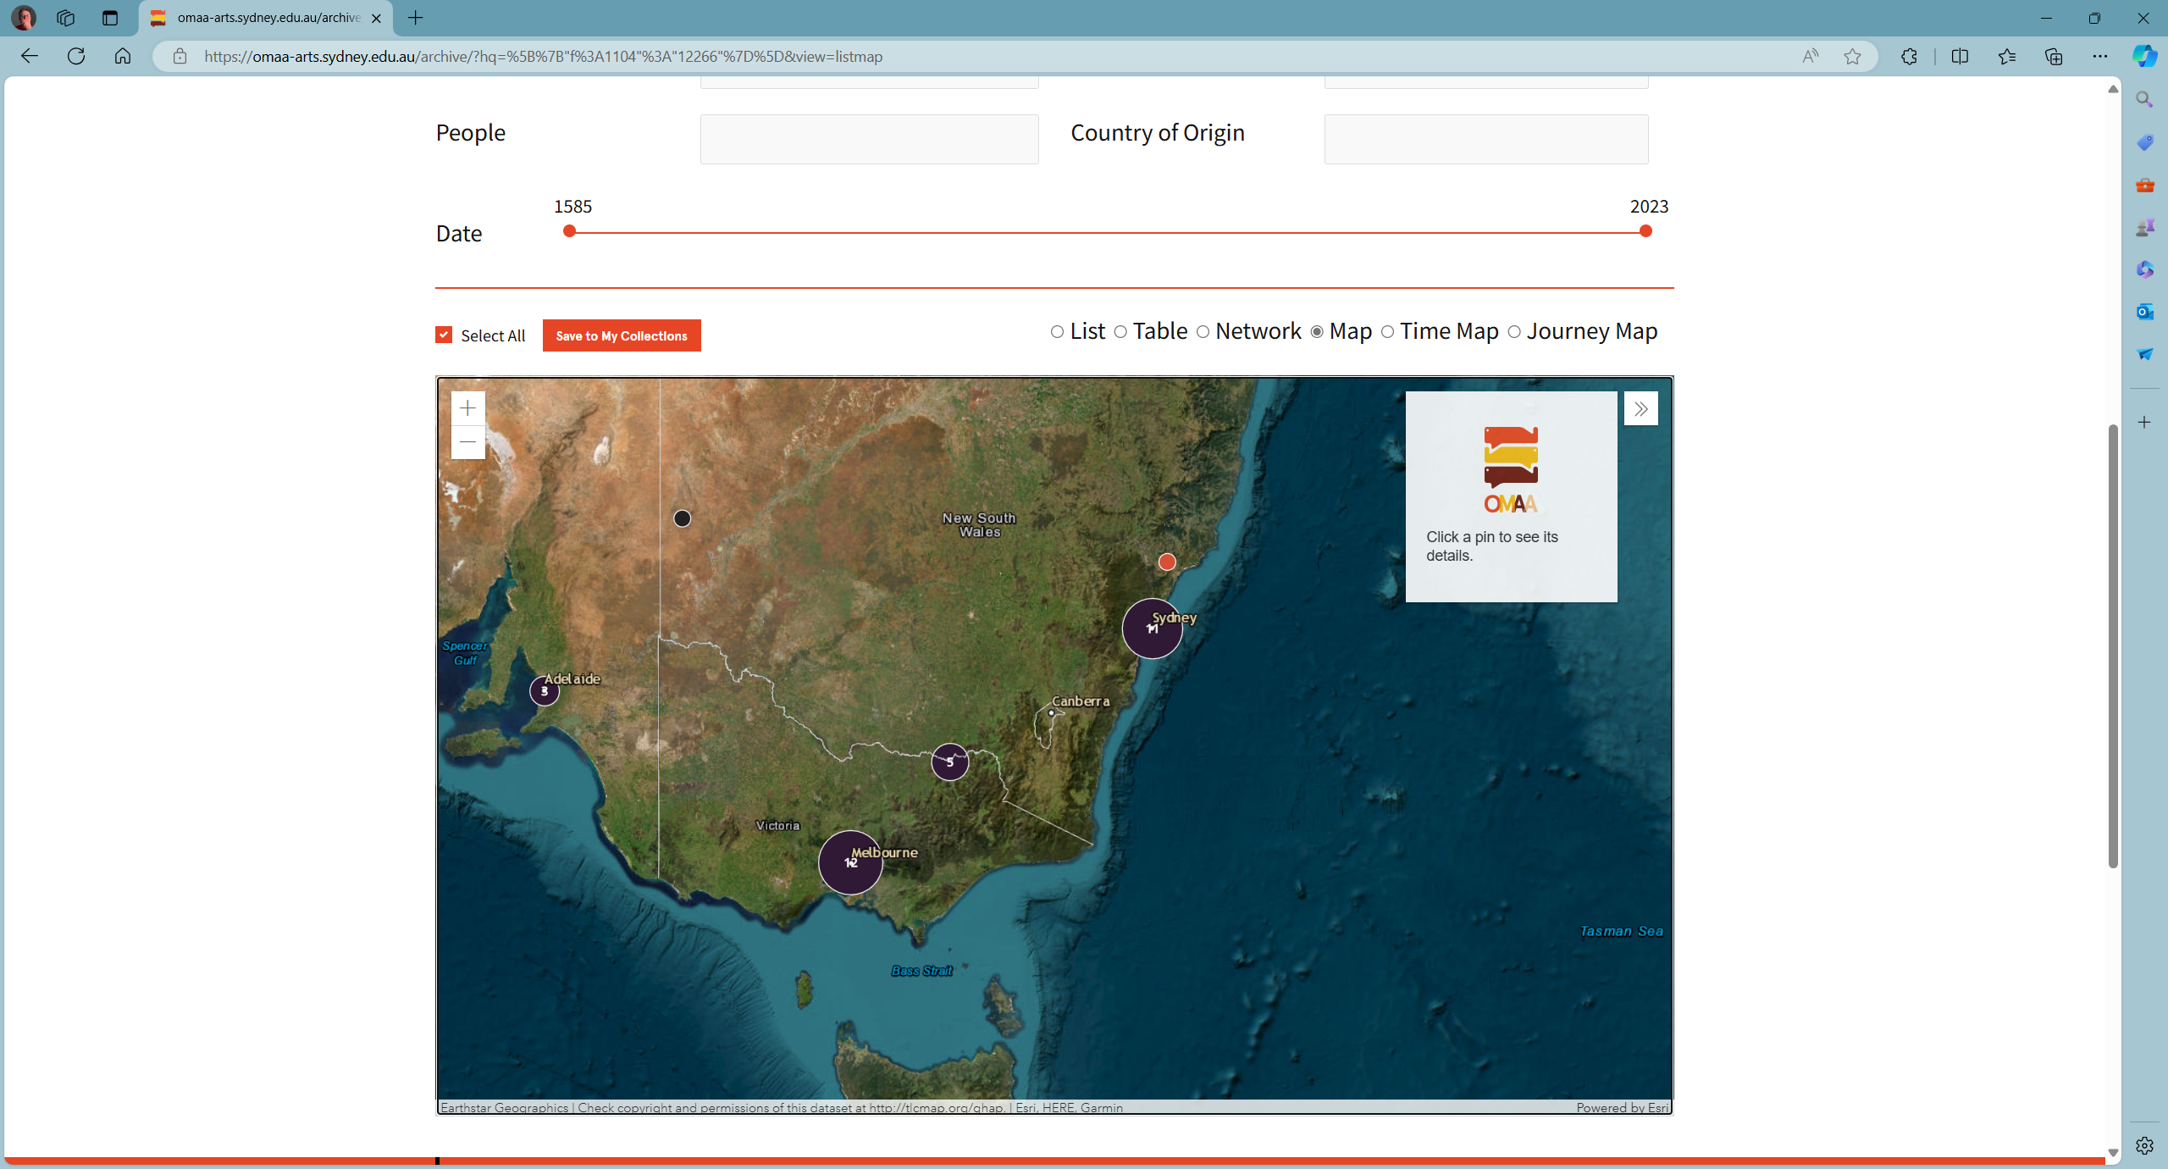
WordPress/Heurist

Slide 9
Relationship Graphing
The digital paradigm for a significant proportion of humanities project can be abstracted as ‘relationship graphing’.
These projects are characterised as incremental, cumulative, granular, and collaborative semantic annotation and linking of heterogenous content and data.
Rather than follow a research paradigm of repeatable experiments (text set-algorithm-result set) the research output is a node graph and a persistent web presence.

Slide 10
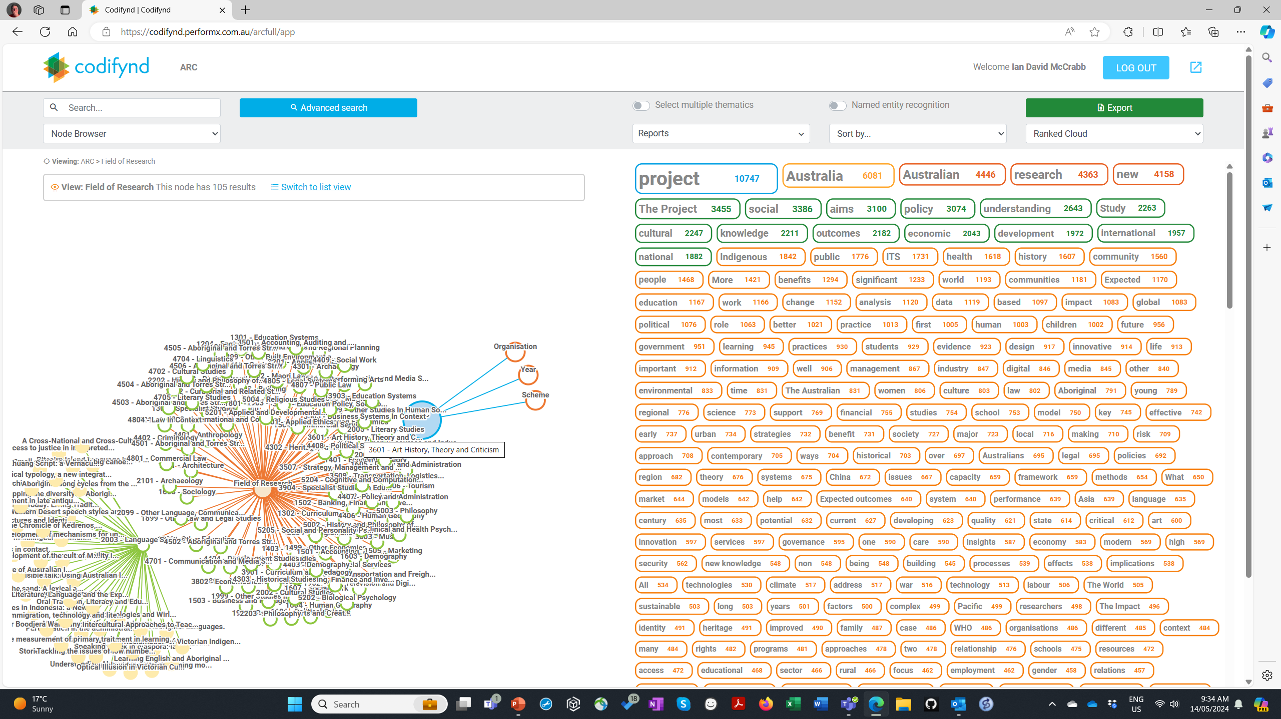
ARC Projects
AI Analysis of ARC Abstracts
Limited to Last 6 Years at USyd, Limited to 2000’s
Of the 35 projects, 21 could be ‘relationship graphing’.
Of these 21, 15 have a high probability of being appropriate for Omeka S as we have planned its implementation and 6 have a medium level of probability.
Of the 15, 3 are currently based on Heurist under Systemik custodianship.
2001 COMMUNICATION AND MEDIA STUDIES
2002 CULTURAL STUDIES
2003 LANGUAGE STUDIES
2004 LINGUISTICS
2005 LITERARY STUDIES
2099 OTHER LANGUAGE, COMMUNICATION AND CULTURE
2101 ARCHAEOLOGY
2102 CURATORIAL AND RELATED STUDIES
2103 HISTORICAL STUDIES
2201 APPLIED ETHICS
2202 HISTORY AND PHILOSOPHY OF SPECIFIC FIELDS
2203 PHILOSOPHY
2204 RELIGION AND RELIGIOUS STUDIES

Slide 11
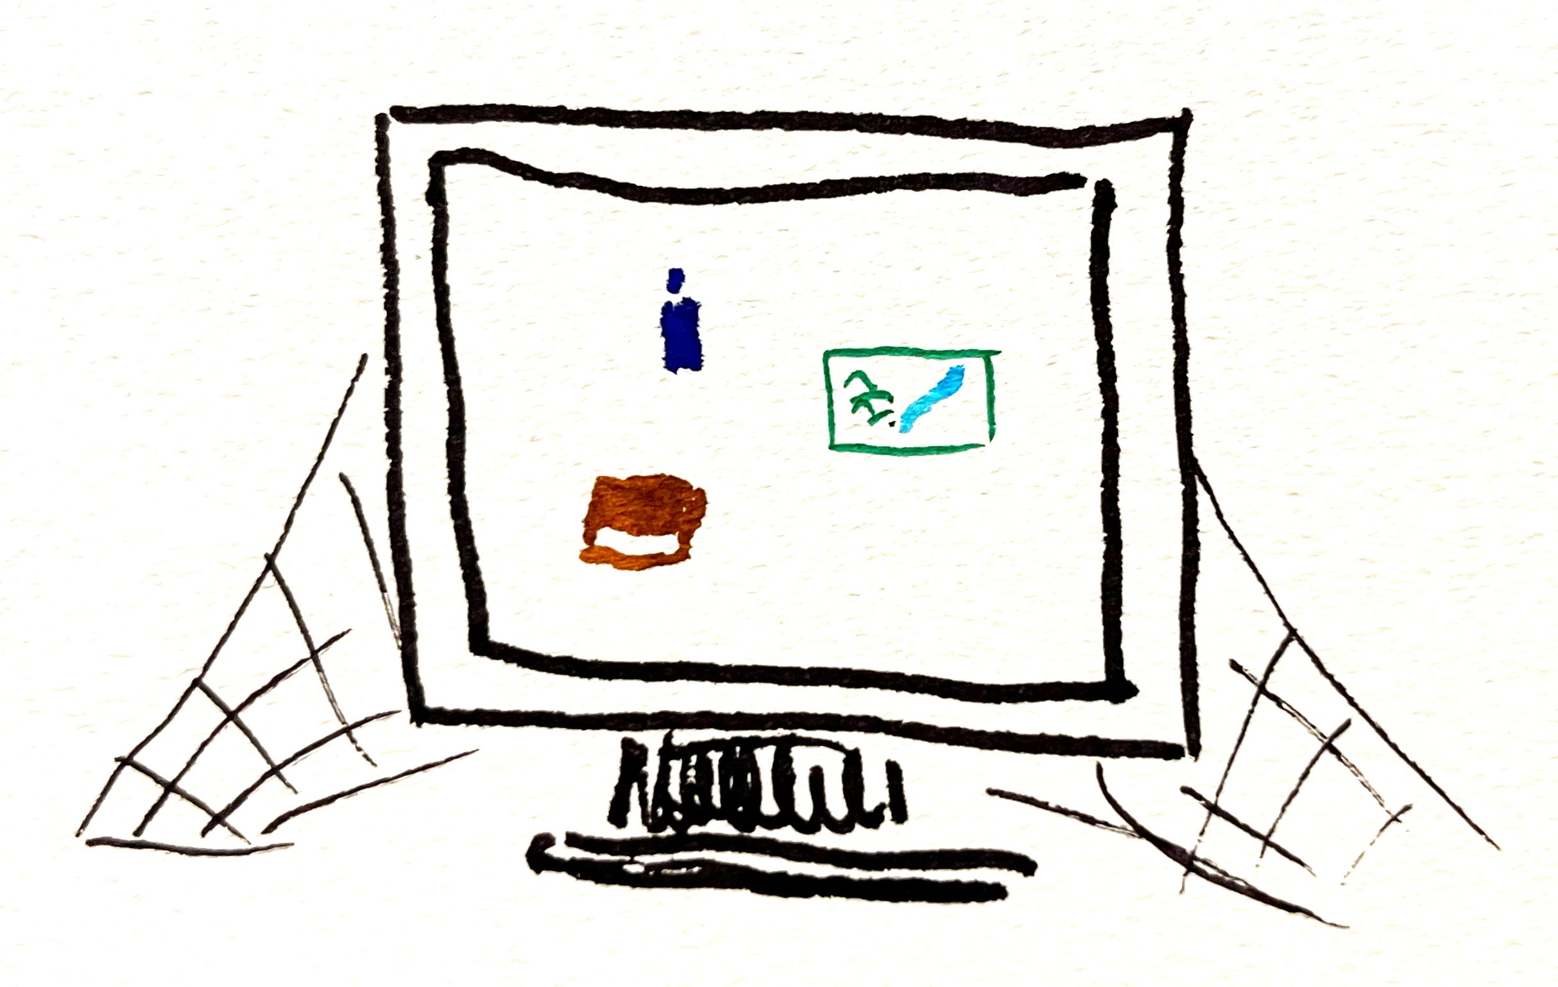
Finding collections at risk
Humanities collections last longer than software
No software platform is forever:
Web standards evolve
Apps have an even shorter shelf-life
Non-scholarly platforms like WordPress
Some at-risk collections get a negative reputation as a pain point
How can we find collections at risk which we don’t know about?
Notes:
Humanities collections have a much longer useful life than any one software application, and it's always easier to get funding to build something new than to keep it going
No software platform is forever:
A web app built in the 90s may still function but won't meet modern standards for security
Apps are a particular bad case: they are appealing to funders but have a really short shelf-life
Platforms like WordPress don't support scholarly metadata
If a platform has high-profile collections but is past its use-by date – and thus hard to support from a technical point of view - it can become an institutional pain point - but at least you know about it!
This is a tricky topic because it gets into questions of how institutions care for their research communities
Question for the group - how can we find the collections at risk which we don’t know about?

Slide 12
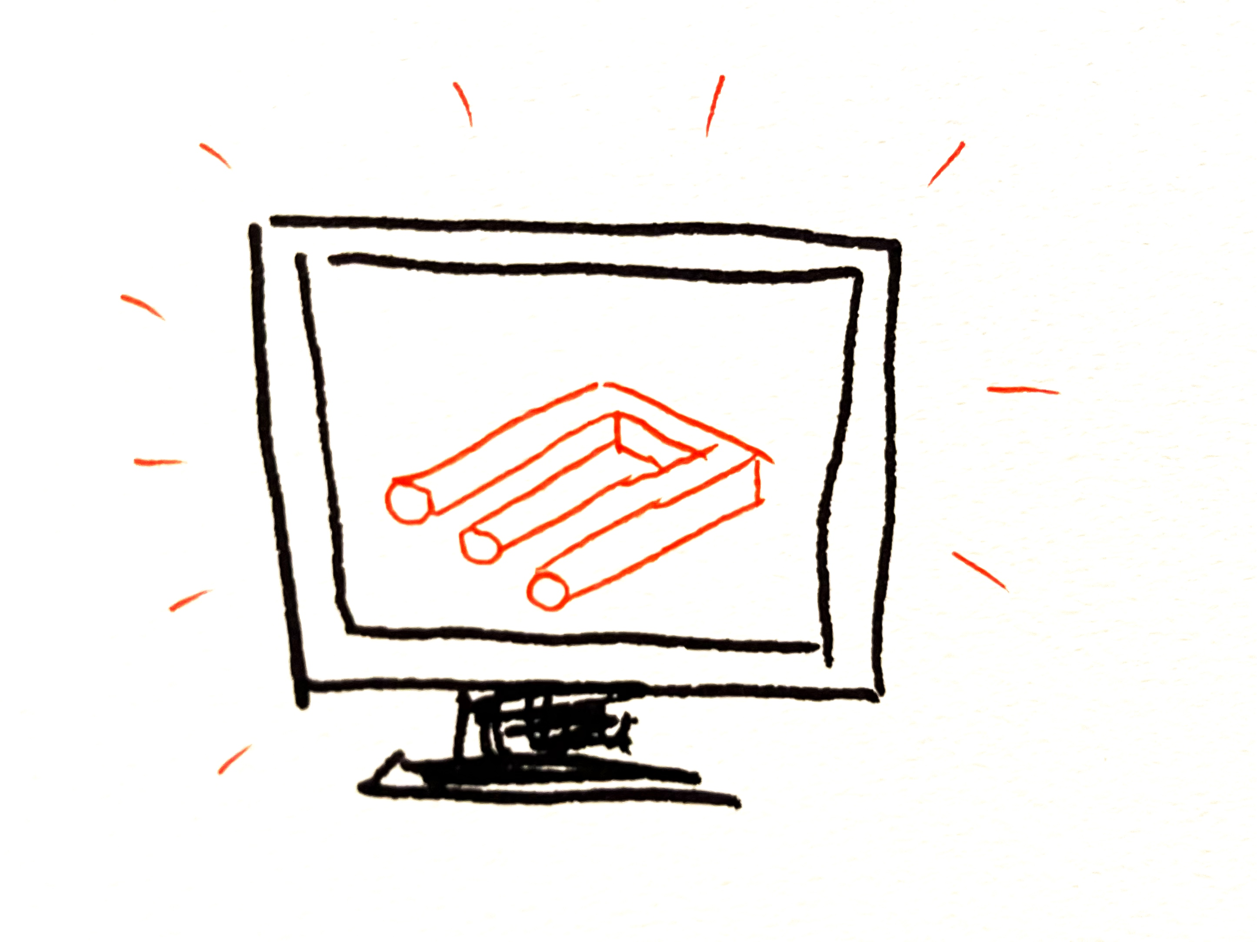
Meeting researcher needs
Avoiding “if you build it, they will come”
Not only about technical requirements
Engagement strategies
“The Humanities” covers a very broad range of disciplines
How do we bring humanities researchers on board?
Notes:
Apart from providing a home for existing collections, we want our platform to be useful to researchers building their collections.
We don't want to do the technical work of standing up the platform and then expect people to come.
This requires us to engage with researchers, both to elicit their requirements, and give them the confidence and skills and support to use the platform.
Some approaches from the group discussion last week
USyd’s project in 2024 - consultations with researchers, asking them to characterise their projects
Prompting a researcher about how they conceptualise their objects of study, not being lead by the platform
Targeting specific disciplines - “humanities” is very broad, quantitative and qualitative researchers have different needs
Consulting approach – look at their collection / spreadsheets / dropbox
Question for the group – how do we bring humanities researchers on board

Slide 13
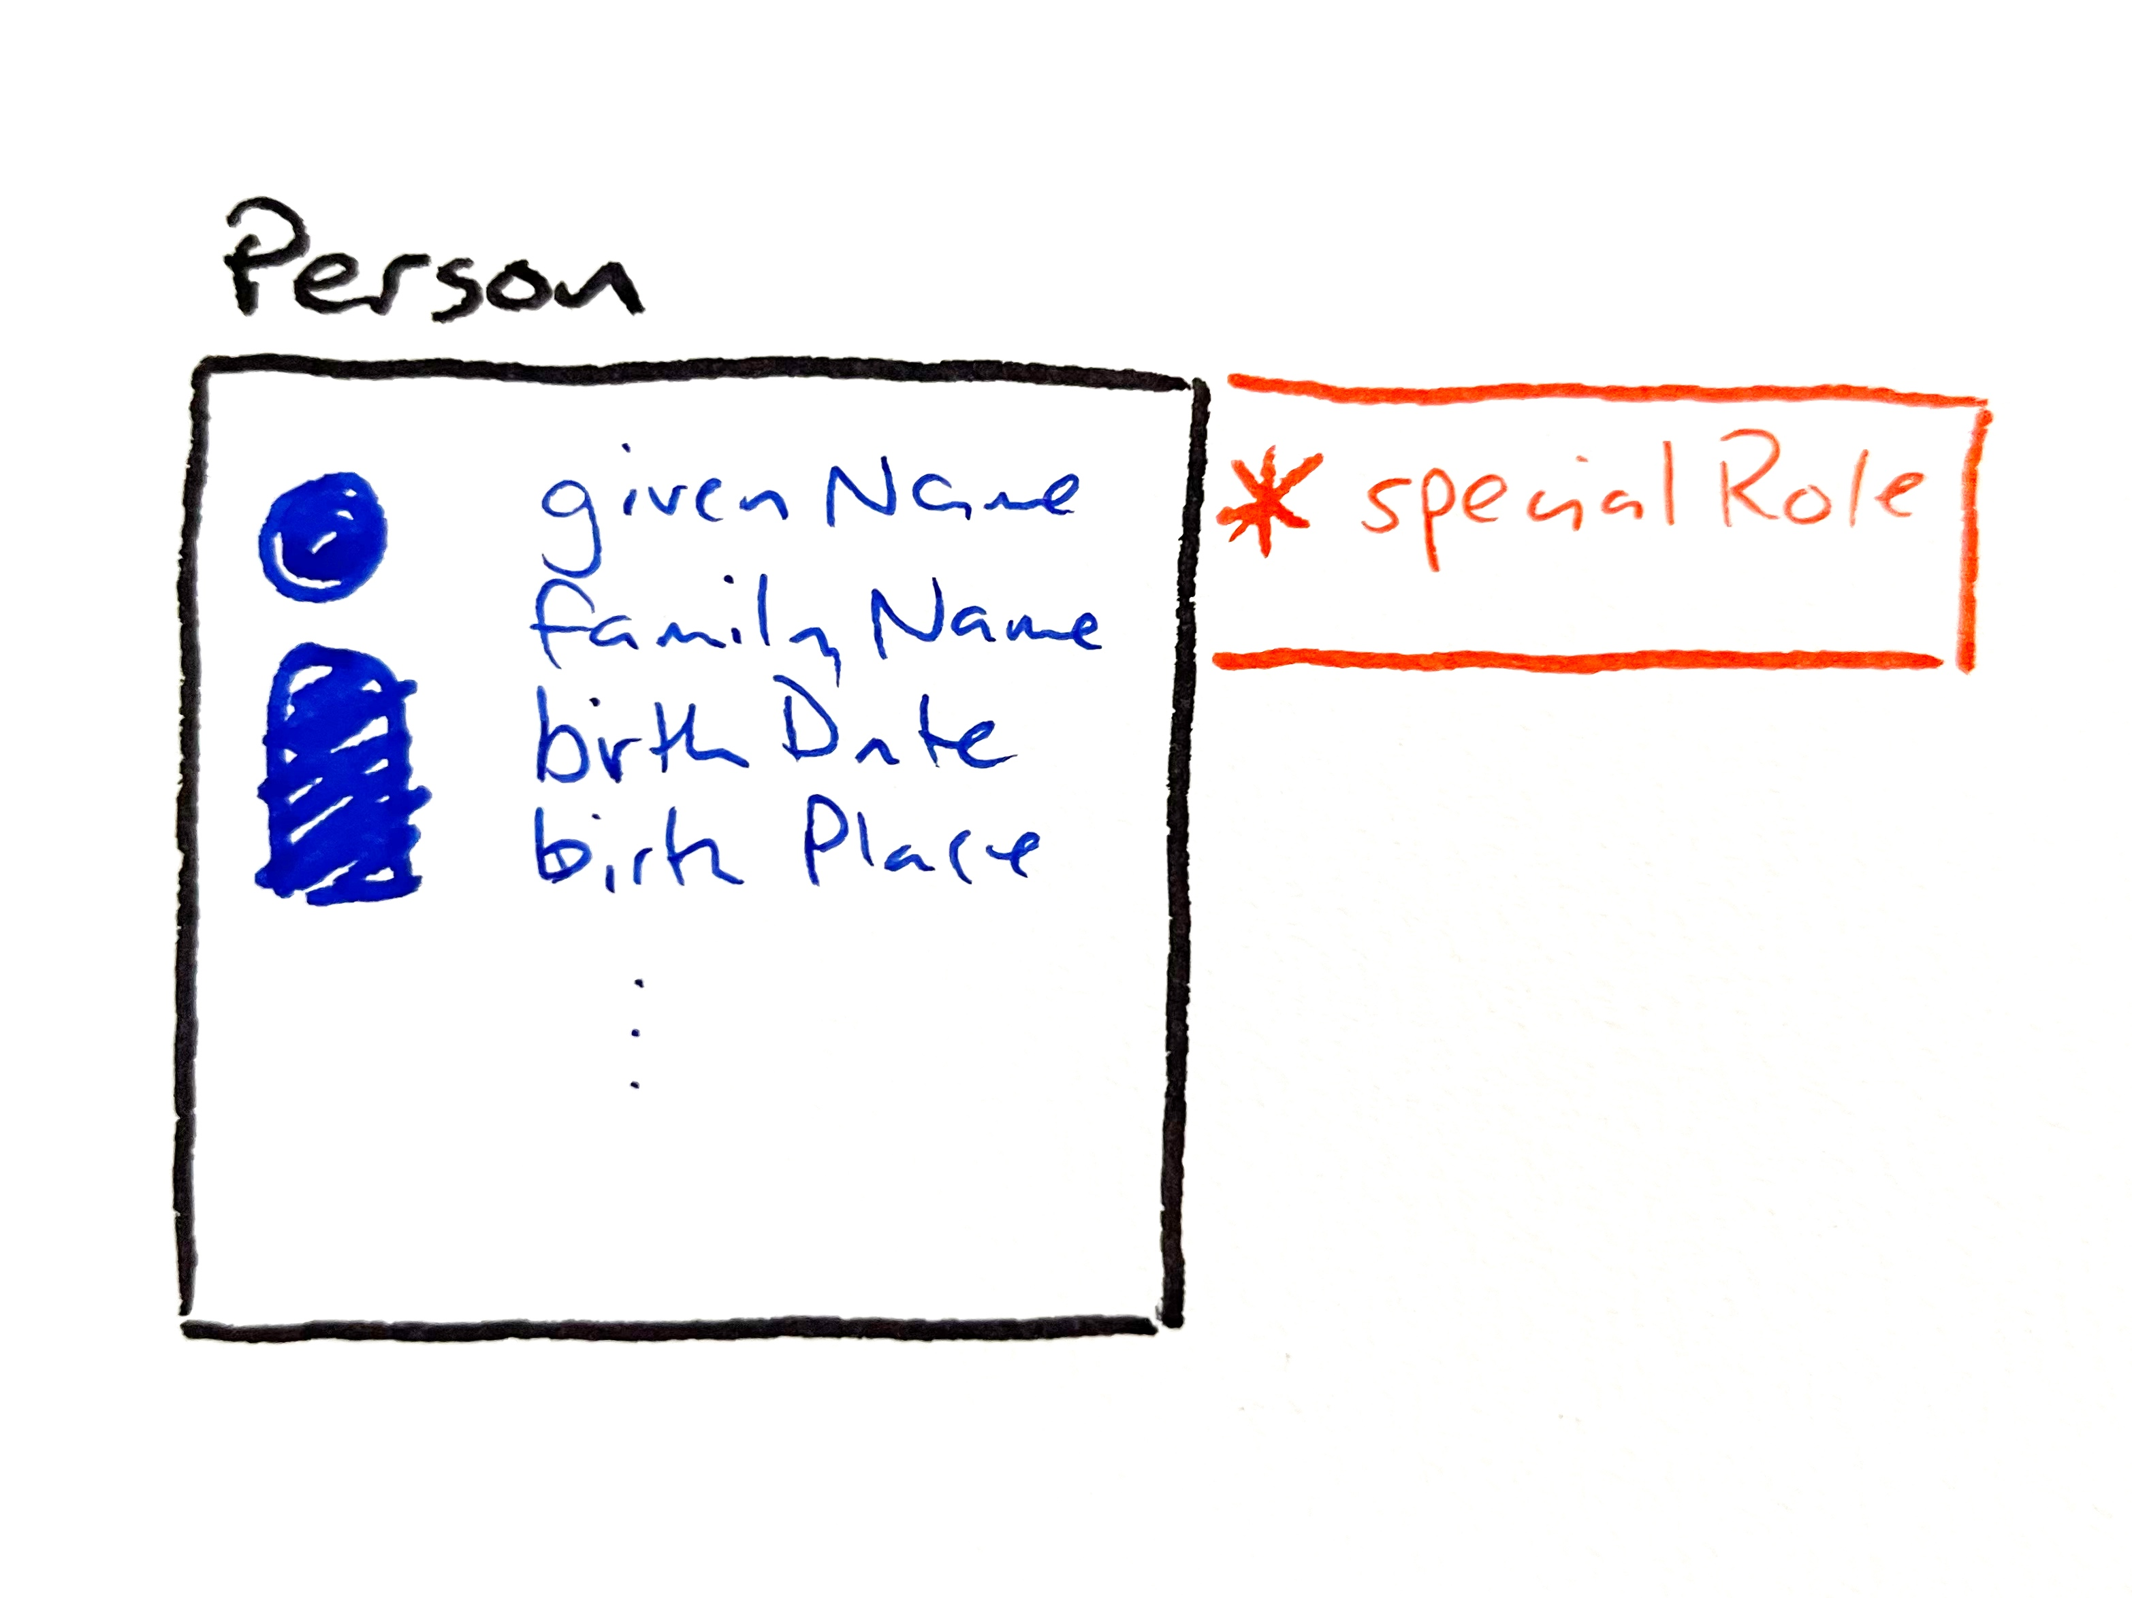
Metadata and standards
Templates for common entities
Mapped to RO-Crate / Schema.org
Good metadata by default
Researchers create their own typologies
Manage all this as as a distribution
How do we ensure metadata quality, while allowing researchers the flexibility they need?
Notes:
One of the deliverables of the Curated Collections project is a set of templates for Omeka S resources which embody good practice and which describe things like documents, artefacts, people, places and events.
We will also have a mapping from these templates to RO-Crates, which means that we can migrate collections out and have good linked-open data practice.
The aim is that just by using the defaults, we get good metadata practice without researchers having to worry about it.
We also want to allow researchers to be able to add their own classifications or typologies as it arises from their research
And we are aiming to have a platform with a standard distribution, including the resource templates and metadata mappings
This is going to be a technical challenge for the project
Question: How do we ensure metadata quality, while allowing researchers the flexibility they need?

Slide 14
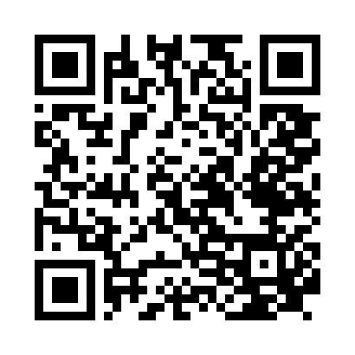
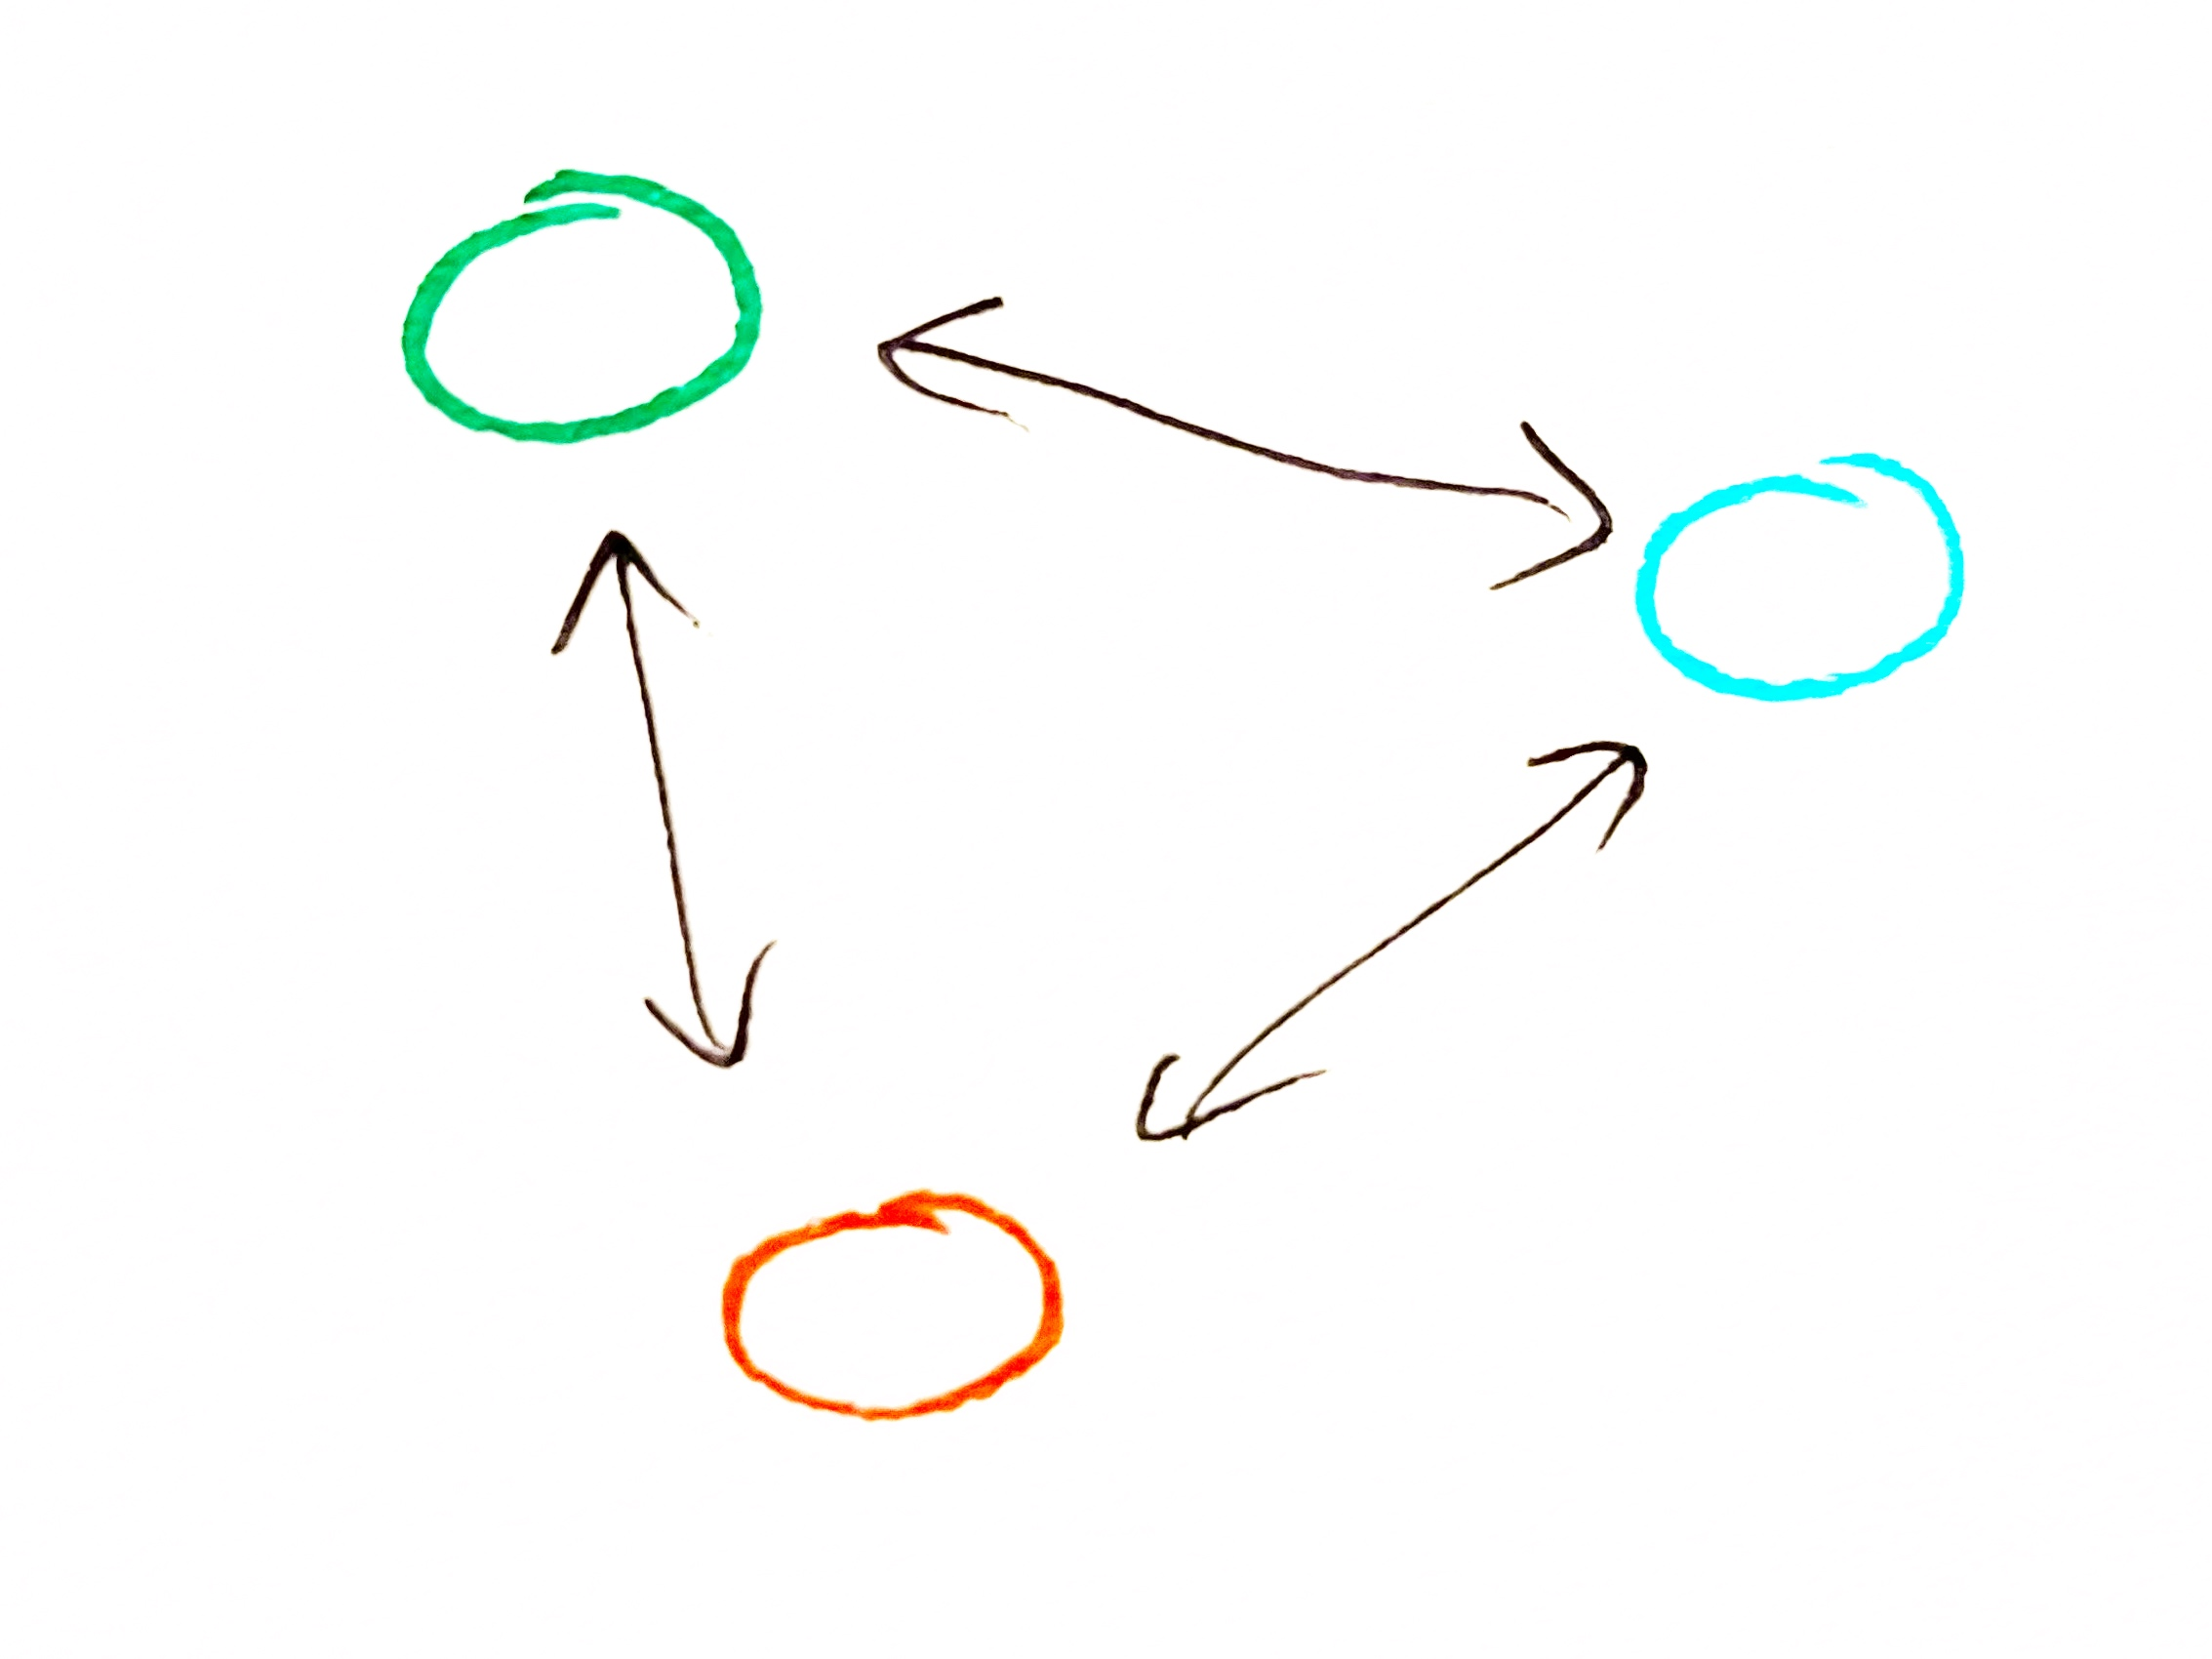
Next steps
Notes from this session – we'll add these to the website (let us know if not)
Community – working groups across the CDL
Slack
What other ways can we keep in touch?
Notes:
Thank you again for coming to this session.
For our next steps, we will be collating the notes you've made and adding them to the project repository – the QR code and the link in the slides take you there.
If there's anything you don't want us to publish, please let me know!
Before that, we have one last prompt: what other ways can we stay in touch?
Working groups for themes like metadata across the other community data labs is one suggestion – these would usually take the form of monthly meetups on Zoom
Projects like LDaCA and BioCommons make a lot of use of Slack – although it can mean one more notification thing to follow.

